Slide 1
Automated Monitoring Of The Process Of Disinfecting Operation Room Using IR Camera
Aum Amriteswaryai Namah
Rittick Maity
AM.EN.P2WNA21007
Center for Wireless Networks & Applications
Advisor:
Mr. Mandar Khandeparker
(Getinge)
Co-Advisor:
Sai Shibu N B (WNA)
Sachin Kalabhavi (Getinge)
09/06/2023

Slide 2
Presentation Outline
Research Gaps
Innovation
System Requirements
Publication Details
Activity Plan
Deliverables
Weekly Meeting Details
Conclusion
Introduction
Motivation
Problem Definition
Objectives
Research Challenges
Literature Review
Approach & Design

Slide 3
Introduction
In the medical field, infection control is of utmost importance, and the proper cleaning and disinfection of operating rooms play a vital role in reducing the risk of infection and complications for patients.
Automated monitoring using IR cameras offers several benefits over manual visual inspection, including objective and consistent assessment of cleanliness, reduced risk of human error, and improved overall quality control.
The development and implementation of an effective and reliable system require addressing several technical and practical challenges, including the need for accurate and sensitive sensors, reliable data processing and analysis, and seamless integration into existing cleaning protocols and workflows.
Overall, the use of NIR cameras for automated monitoring of the disinfection process represents a promising and innovative approach to improve infection control and reduce the risk of complications for patients undergoing procedures in operating rooms.

Slide 4
Motivation
The development of automated monitoring of the disinfection process in operating rooms is an essential research area due to the critical role that cleaning, and disinfection play in preventing healthcare-associated infections (HAIs).
According to the Centers for Disease Control and Prevention (CDC), HAIs affect an estimated 1 in 31 hospital patients, leading to prolonged hospital stays, increased healthcare costs, and, in severe cases, mortality. Proper cleaning and disinfection of operating rooms are essential to reduce the risk of HAIs and improve patient outcomes.

Slide 5
Problem Definition
Cleaning and disinfection of operating rooms have relied on manual visual inspection, which is subjective and can lead to inconsistencies in the cleaning process. This can result in areas being missed or not adequately disinfected, which can lead to an increased risk of infection.

Slide 6
Research Objective
The main objective is to develop a system that can monitor the temperature of the operation room during the disinfection process using an IR camera.
The IR camera will be connected to a microcontroller such as Raspberry Pi, which will be responsible for capturing the temperature readings.
The temperature data will be analyzed in real-time using a software program and compared with the set temperature range for the disinfection process.
If the temperature falls outside the set range, an alert will be generated to notify the concerned authorities.
The temperature monitoring system can be used in conjunction with other monitoring systems to ensure that the entire disinfection process is closely monitored and controlled.

Slide 7
Research Challenges
The selection of a suitable IR camera for the automated monitoring system is critical to ensure the accuracy and reliability of the data.
This IR camera exclusively focuses on a specific area, ensuring that it gets cleaned thoroughly.
The development of image processing algorithms to analyze the IR camera images and detect residual contaminants may require significant expertise and resources.
Developing algorithms and software to process the data captured by the IR camera and provide real-time feedback on the cleanliness of the room.
Ensuring that the system is easy to use and can be integrated seamlessly into existing disinfection protocols without disrupting clinical workflows.

Slide 8
Literature Review Resources
Sl NO | Title | Authors | Conference/Journal/Book/Website | Year of Publication
1. | Design and Modeling of IoT IR Thermal Temperature Screening and UV Disinfection Sterilization System for Commercial Application using Blockchain Technology. | Sivajothi Paramasivam, Chua Huang Shen*, Alireza Zourmand, Amira Kamil Ibrahim, Ahmed Mohamed Alhassan, Abdelwhab Faroug Eltirifl | International Conference on System Engineering and Technology | 2020
2. | Development of Android-Controlled Ultraviolet Floor Sanitizer Robot | Husna Nabihah Awang, Zuhanis Mansor, Izanoordina Ahmad, Aizat Faiz Ramli, Siti Marwangi Maharum, Azman Abdul Aziz | International Conference on Smart Instrumentation, Measurement and Applications | 2022

Slide 9
Literature Review Resources
Sl NO | Title | Authors | Conference/Journal/Book/Website | Year of Publication
3. | Holistic operating room hygiene control for air and surface cleanliness | Kim Hagström, Ismo Grönvall | CLIMA 2022 The 14th REHVA HVAC World Congress | 2022
4. | A Human Support Robot for the Cleaning and Maintenance of Door Handles Using a Deep-Learning Framework | Balakrishnan Ramalingam, Jia Yin Mohan Rajesh Elara Yokhesh Krishnasamy Tamilselvam MadanMohan Rayguru M. A. Viraj J.Muthugala and Braulio FélixGómez | Molecular Diversity Preservation International | 2020

Slide 10
Literature Summary
Paper 1: Design and Modeling of IoT IR Thermal Temperature Screening and UV Disinfection Sterilization System for Commercial Application using Blockchain Technology.
The introduction of the paper discusses the global health crisis caused by the emergence of COVID-19 and the strain it has put on healthcare systems, particularly in developing countries.
The paper highlights the inadequacy of healthcare systems to deal with the crisis and the shortage of personal protective equipment for healthcare workers.
The paper also mentions the strict containment measures imposed by many countries to fight against the pandemic.
The paper does not provide any specific results as it is a conceptual design proposal for an IoT IR Thermal Temperature Screening and UV Disinfection Sterilization System for commercial application using blockchain technology

Slide 11
Literature Summary
Paper 2: Development of Android-Controlled Ultraviolet Floor Sanitizer Robot
The paper discusses the development of an Android-controlled ultraviolet floor sanitizer robot that uses UVC light to sanitize surfaces and inactivate bacteria such as superbugs and Covid-19 viruses.
The robot is equipped with ultrasonic sensors to detect obstacles and provide autonomous movement, while a PIR sensor detects human motion and activates a human alert system.
The paper concludes that it is an effective tool for sanitizing low areas such as floors.

Slide 12
Literature Summary
Paper 3: Holistic operating room hygiene control for air and surface cleanliness
The paper discusses the importance of maintaining air and surface cleanliness in operating rooms to minimize the risk of surgical site infections.
The system can control the whole integrated building services system of ventilation, blue-light disinfection, and general lighting, which simplifies the working process of operation room personnel and enables optimal use of room with integrated building services based on the actual operation mode. The blue light disinfection system was designed to provide 99% disinfection performance during 3,5 hours in the whole operating room and even in 1 hour in the most critical room center.

Slide 13
Literature Summary
Paper 4: A Human Support Robot for the Cleaning and Maintenance of Door Handles Using a Deep-Learning Framework
The paper describes the experimental results of door detection and the cleaning mechanism. The experiment has three phases, which are training the deep-learning framework, mapping the indoor environment, and configuring and testing with HSR robot platform.
The dataset preparation process involves collecting the different door images at high resolution. The dataset contains about 4500 images collected online through Bing image search, the Miguel et al. [39] door dataset and also our institution's different door handles.
The proposed technique uses a deep-learning-based detection and classification algorithm to identify the door handles and generate a set of coordinates surrounding them.

Slide 14
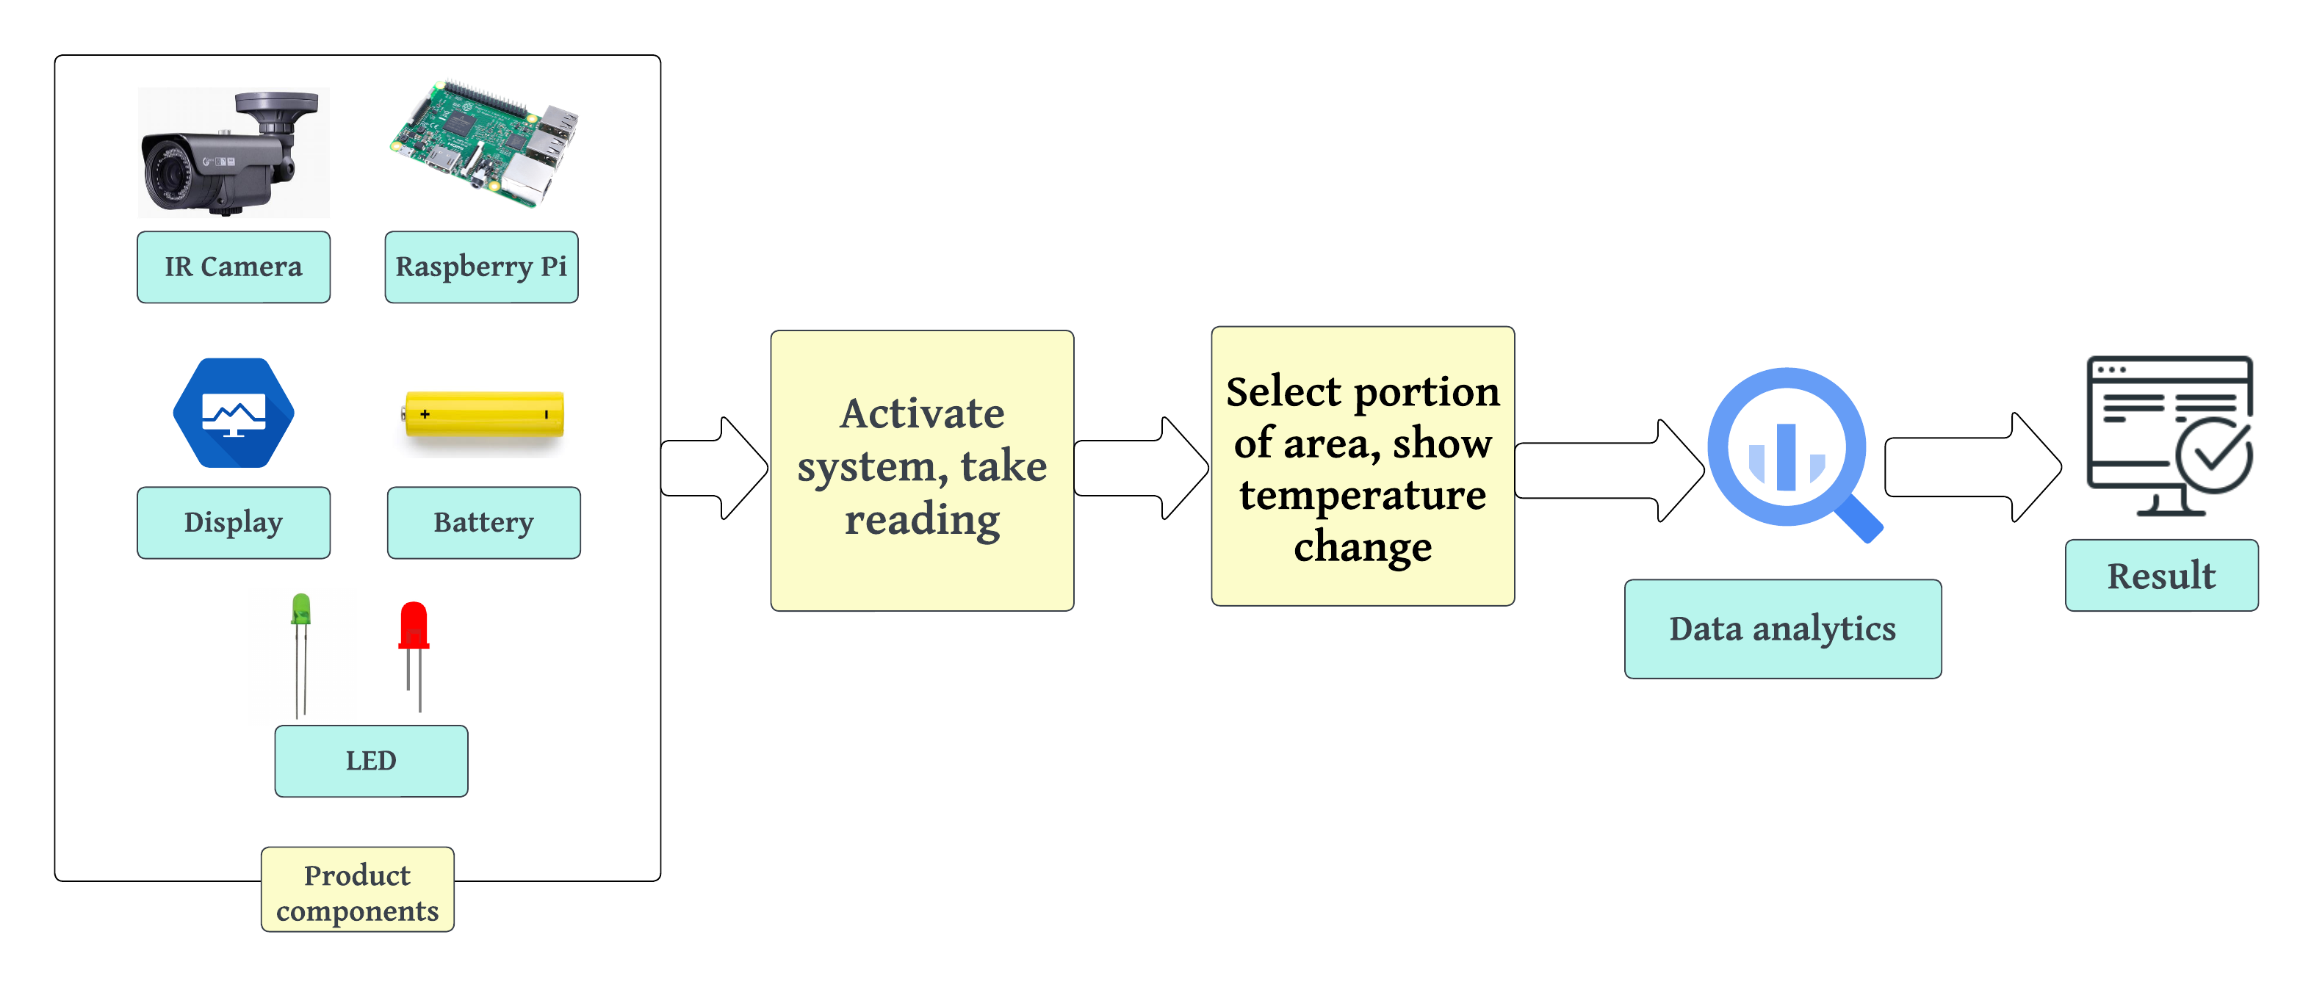
System Architecture

Slide 15
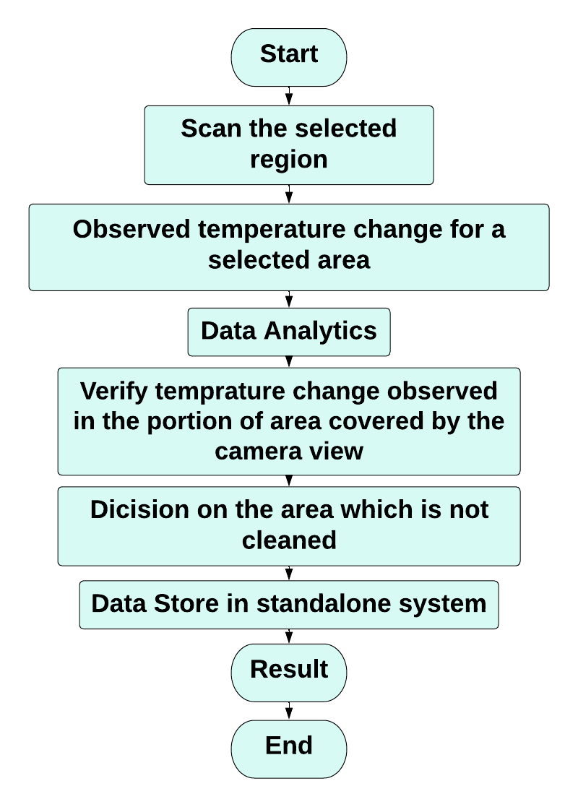
System Flowchart

Slide 16
Software Requirements
Sl No | Software | Description | Open source/ Licensed | Been installed in lab PC
1 | Thonny | Python IDE | Open source | yes
2 | CoLAB | Online python IDE | Open Source | yes

Slide 17
Hardware Requirements
Sl No | Component Name | Vendor/Online reseller | Available/To be purchased?
1 | Raspberry Pi 4B | Amazon | Yes
2 | AMG8833 Thermal Imaging Sensor | Amazon | Yes
3 | Display |  | Yes
4 | LED | Amazon | Yes

Slide 18
Publication details
Paper Title | Name of Conference/Journal | Place & Conference date | Status
Maximising Highway Safety through AI-enabled Detection of Pedestrians and Animals in V2X Environments | Wispnet 2023 | Chennai | Published
Project Title
Date
Date
Project Title

Slide 19
Deliverables
Hardware setup
Software installation
Source code
Testing and Deployment
Paper publication

Slide 20
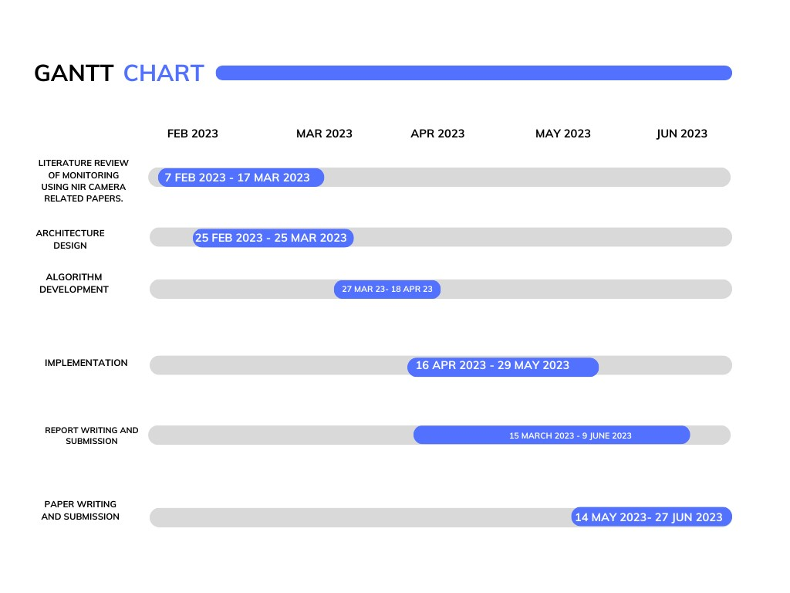
Activity Plan

Slide 21
Weekly Meetings
Sl. No | Date | Time Duration | Topic | Advisors Suggestion | Incorporated Advisors Previous Suggestions
1 | 20-05-2023 | 15 mins | Demo | - | yes
2 | 25-05-2023 | 30 mins | Implementation | - | yes
3 | 28-05-2023 | 15 mins | Demo | - | yes

Slide 22
Implementation
Hardware Setup:
Connect the AMG8833 thermal imaging sensor to the Raspberry Pi 4B following the sensor's documentation and pinout guide.
Connect the green and red LEDs to the GPIO pins of the Raspberry Pi for temperature indication.
Ensure all connections are secure and properly seated.
Software Installation:
Install the operating system on the Raspberry Pi (e.g., Raspbian or suitable alternative) and set it up.
Install the necessary libraries and dependencies for the AMG8833 sensor, GPIO control, and data visualization. For example:
Install the Adafruit_AMG88xx library for interacting with the AMG8833 sensor.
Install the RPi.GPIO library for controlling the GPIO pins.
Install the pygame library for graphical display.

Slide 23
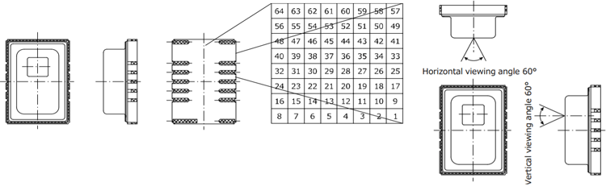
Thermal imaging sensor description
Pixel resolution: 8x8 (64 Pixels) Temperature measurement range: -20°C to 80°C Field of view: 60 degrees horizontal, 60 degrees vertical I2C address: 0x69 (default) or 0x68 (selectable) Operating voltage: 3.3V or 5V Operating current: 4.5mA (typical)
Pins:
VIN: Power supply voltage input (2.7V to 3.3V)
GND: Ground
SCL: I2C clock line
SDA: I2C data line
INT: Interrupt output (active low)
AD0: I2C address selection pin (low for 0x69, high for 0x68)
Fig: AMG8833 Thermal Imaging Sensor

Slide 24
Implementation Code
from Adafruit_AMG88xx import Adafruit_AMG88xx
import pygame
import os
import math
import time
import RPi.GPIO as GPIO
import numpy as np
from scipy.interpolate import griddata
from colour import Color
# GPIO pin numbers for the LEDs
GREEN_LED_PIN = 17
RED_LED_PIN = 18
# Threshold temperatures for LED activation
LOW_THRESHOLD = 24.0
HIGH_THRESHOLD = 30.0
# Initialize the GPIO pins
GPIO.setmode(GPIO.BCM)
GPIO.setup(GREEN_LED_PIN, GPIO.OUT)
GPIO.setup(RED_LED_PIN, GPIO.OUT)
# Initialize the sensor
sensor = Adafruit_AMG88xx()
# Configuration for pygame display
os.putenv('SDL_FBDEV', '/dev/fb1')
pygame.init()
# Configuration for thermal display
MINTEMP = 24
MAXTEMP = 30
COLORDEPTH = 1024
height = 240
width = 240
blue = Color("indigo")
colors = list(blue.range_to(Color("red"), COLORDEPTH))
colors = [(int(c.red * 255), int(c.green * 255), int(c.blue * 255)) for c in colors]
displayPixelWidth = width / 30
displayPixelHeight = height / 30
lcd = pygame.display.set_mode((width, height))
lcd.fill((255, 0, 0))
pygame.display.update()
pygame.mouse.set_visible(False)
lcd.fill((0, 0, 0))
pygame.display.update()

Slide 25
Implementation Code
# Utility functions
def constrain(val, min_val, max_val):
return min(max_val, max(min_val, val))
def map(x, in_min, in_max, out_min, out_max):
return (x - in_min) * (out_max - out_min) / (in_max - in_min) + out_min
# Let the sensor initialize
time.sleep(0.1)
while True:
# Read the pixels
pixels = sensor.readPixels()
pixels = [map(p, MINTEMP, MAXTEMP, 0, COLORDEPTH - 1) for p in pixels]
# Perform interpolation
points = [(math.floor(ix / 8), (ix % 8)) for ix in range(0, 64)]
grid_x, grid_y = np.mgrid[0:7:32j, 0:7:32j]
bicubic = griddata(points, pixels, (grid_x, grid_y), method='cubic’)
# Draw everything on the display
for ix, row in enumerate(bicubic):
for jx, pixel in enumerate(row):
pygame.draw.rect(lcd, colors[constrain(int(pixel), 0, COLORDEPTH - 1)],
(displayPixelHeight * ix, displayPixelWidth * jx, displayPixelHeight, displayPixelWidth))
# Update the pygame display
pygame.display.update()
# Calculate the average temperature
average_temp = np.mean(bicubic)
# Determine LED status based on temperature thresholds
if average_temp < LOW_THRESHOLD:
GPIO.output(GREEN_LED_PIN, GPIO.HIGH)
GPIO.output(RED_LED_PIN, GPIO.LOW)
elif average_temp > HIGH_THRESHOLD:
GPIO.output(GREEN_LED_PIN, GPIO.LOW)
GPIO.output(RED_LED_PIN, GPIO.HIGH)
else:
GPIO.output(GREEN_LED_PIN, GPIO.LOW)
GPIO.output(RED_LED_PIN, GPIO.LOW)

Slide 26
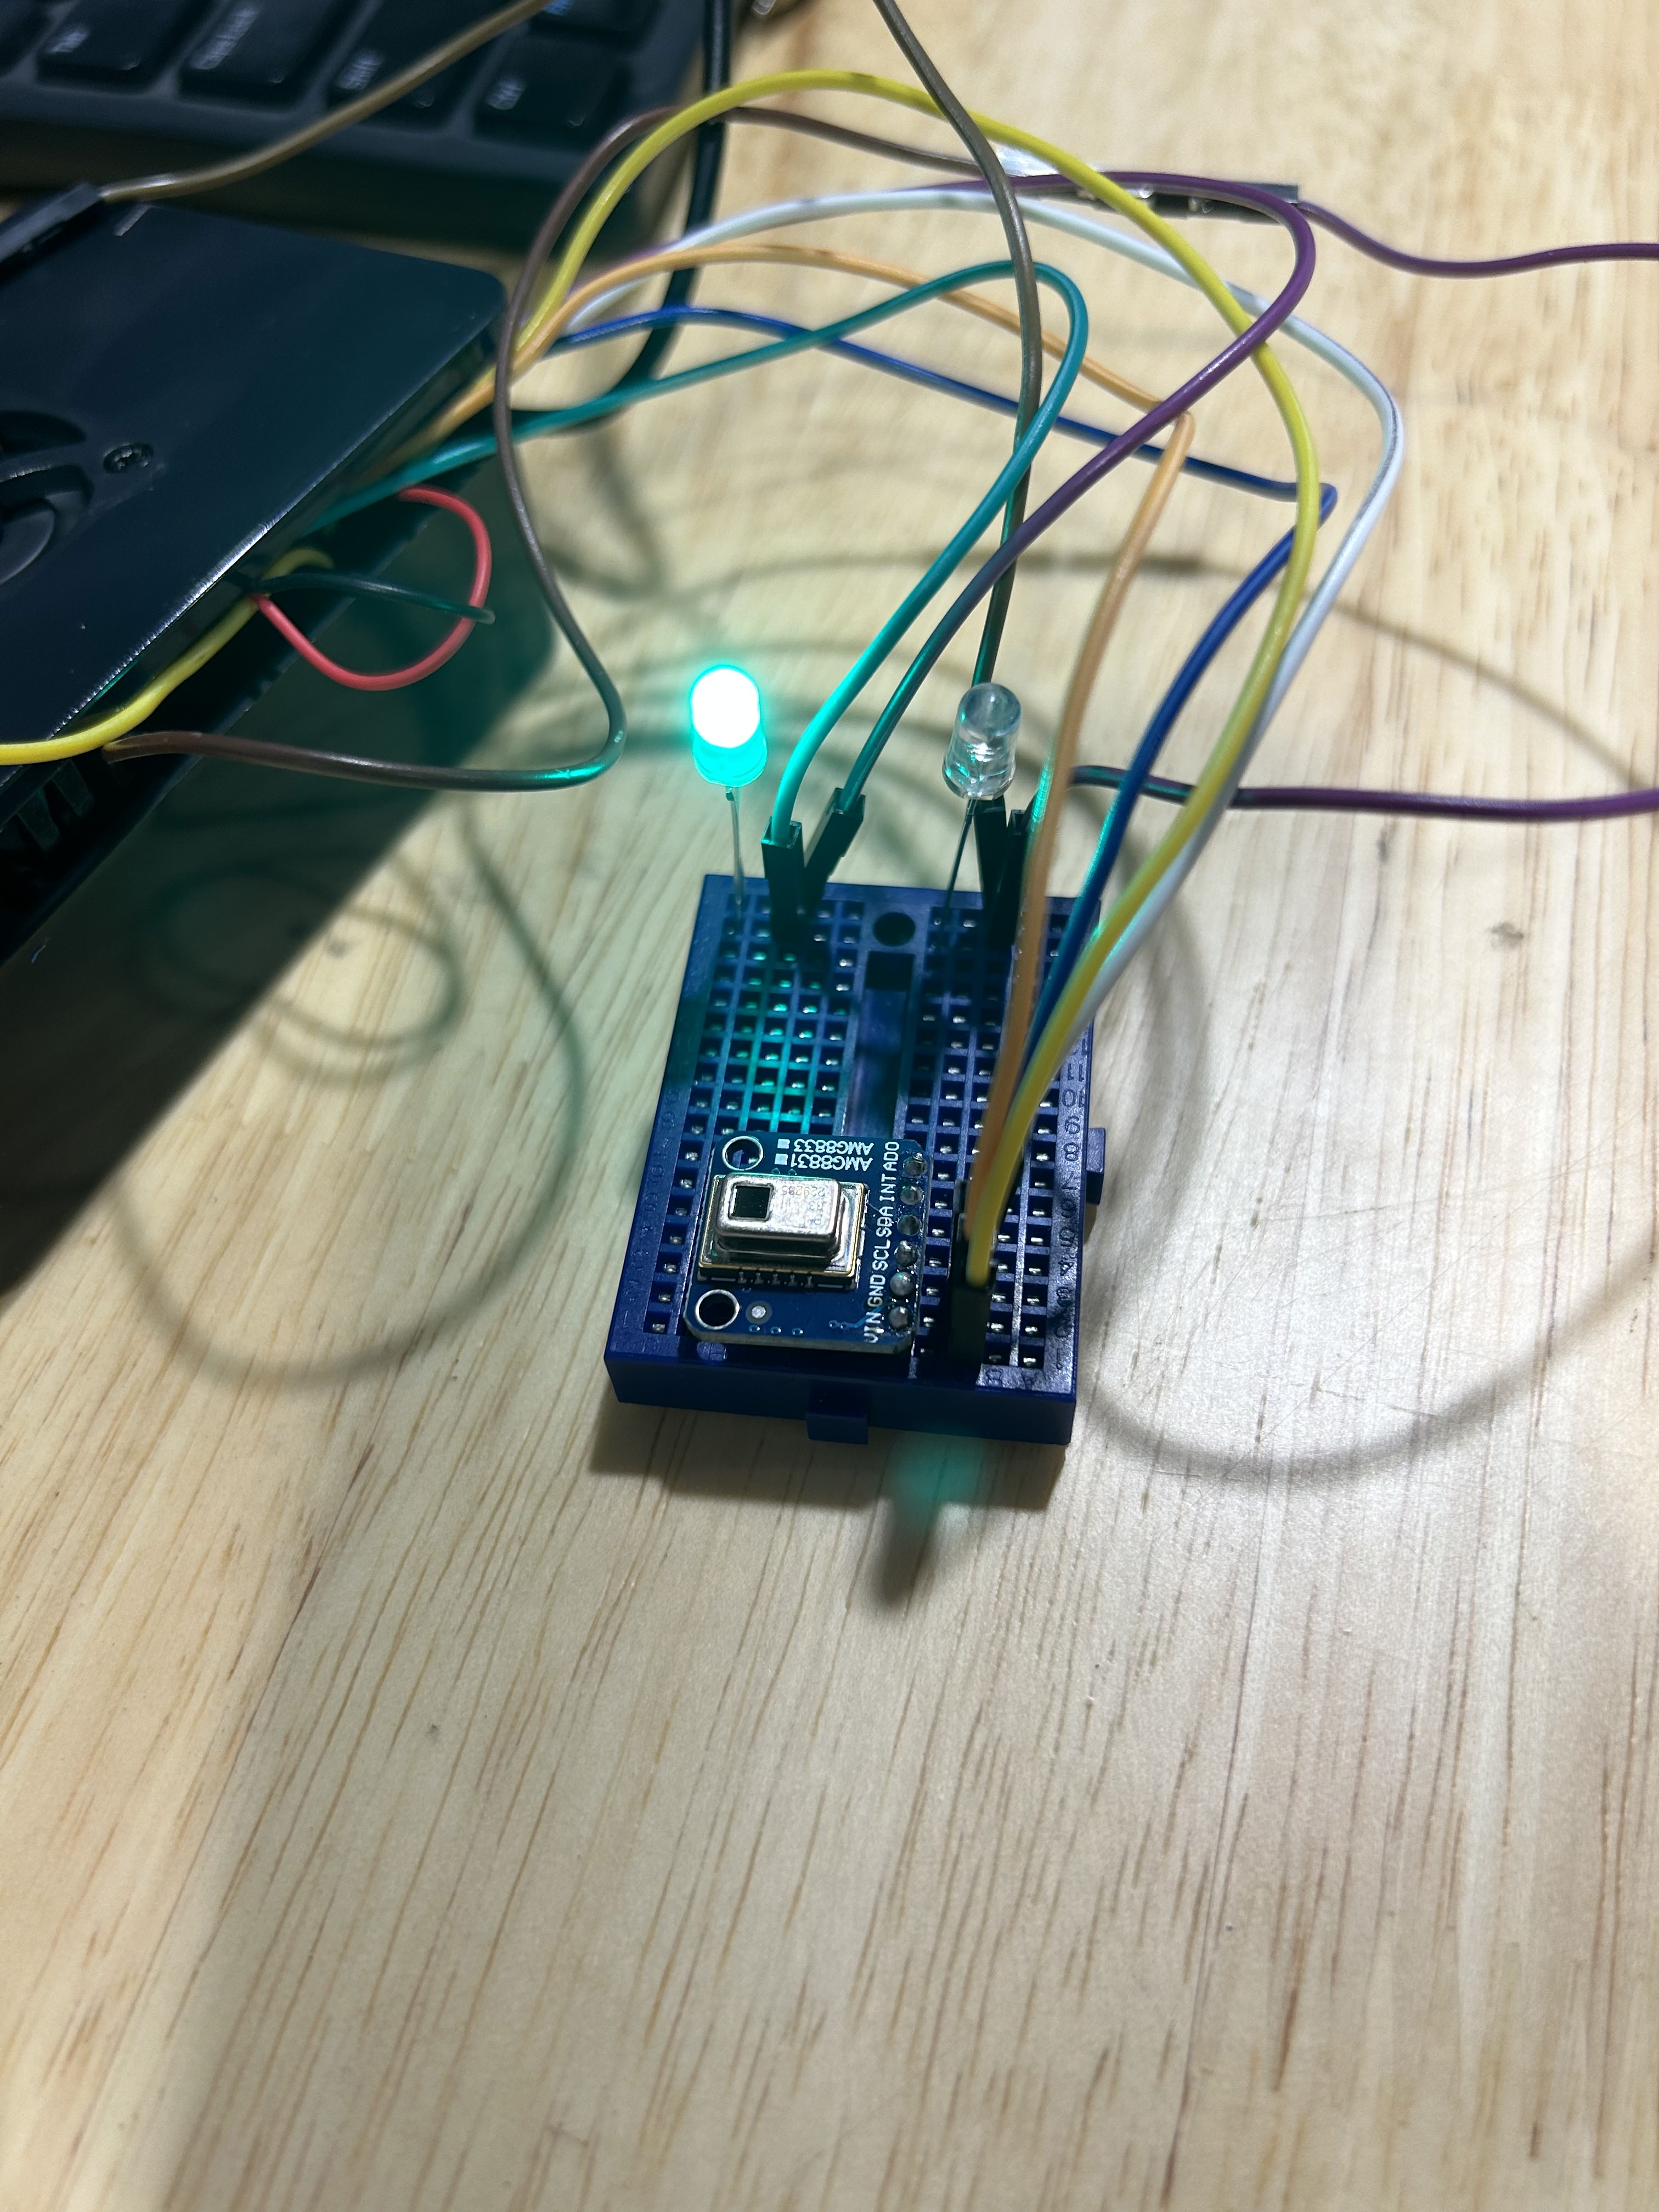
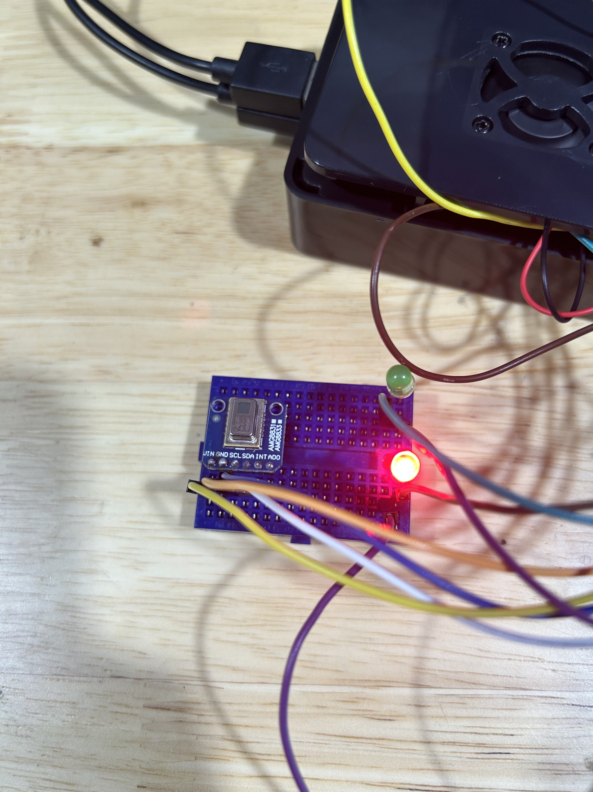
Performance Analysis
When temperature 24°C to 30°C
When temperature above 30°C

Slide 27
Work to be done
Use the “picamera” library to initialize the camera and capture an image.
Convert the captured image to a suitable format for image processing.
Use image processing techniques to analyze the captured image.
Apply algorithms or filters to extract relevant features or information from the image.

Slide 28
Conclusion
The integration of the AMG8833 thermal imaging sensor with the Raspberry Pi and the implementation of image processing capabilities open up new possibilities for monitoring and analysis.
By combining the thermal data from the sensor with the visual information from the Raspberry Pi camera, it becomes possible to obtain a comprehensive understanding of the environment's temperature distribution and visual characteristics.
Overall, this integration enhances the capabilities of the Raspberry Pi and enables a wide range of applications in fields such as surveillance, automation, and environmental monitoring.

Slide 29
Thank You
Rittick Maity

